Slide 1
INTELLIGENT ALBUM MANAGER using Aws-s3 bucket
Presented By: SUPERVISED BY:
H. POOJA(575) mr.y.madan reddY
K. Sai Chandana(5A0) ASSISTANT PROFESSOR
k. Thanuja(5B4)

Slide 2


Slide 3
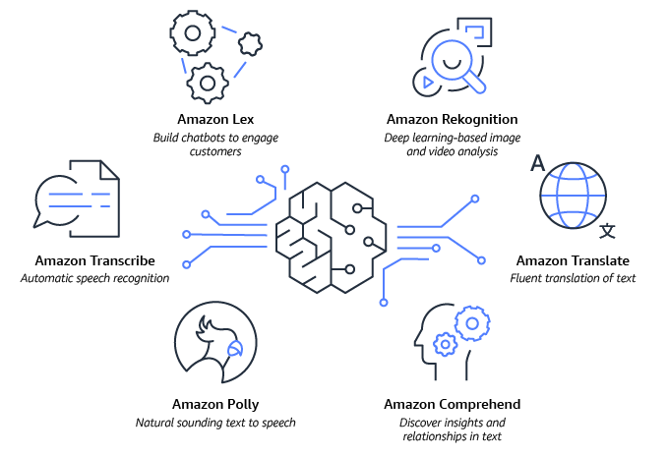

Slide 4
Contents
Introduction
Working
About S3 Bucket
Flask app
Architecture
Conclusion

Slide 5
Introduction
Many people make photo albums of their family or close friends. But have a hard time finding photos of particular people which they want or to sort them according to that.
With this application, you can simply choose some photos as a collection of the different faces available in the album and sort all the photos at once by the face detected in each photo.
The application is purely based on the AWS rekognition client (and its services) and AWS s3 ( storage).

Slide 6
working
The basic working of the application is to take a source image and compare it with all the faces in the collection to find a match.
As soon as we get a match, the program will put that particular photo in the folder of the person whose face was detected.
It’ll run in a loop until we get all our photos sorted, all we need to do is just upload the photos and ask our intelligent album manager to do its magic.

Slide 7
activities involved are :
Data collection
Creating an S3 bucket
Uploading the images to S3 bucket
Creating the collection
Adding faces to collection
Using the rekognition service to search images by faces.
Put the image into the respective folder after being recognized.
Application building :
Create an html file
Build python code

Slide 8
Aws s3 Bucket :
Amazon simple storage service (amazon S3).
It is an object storage service that offers industry-leading scalability, data availability, security, and performance.
This means customers of all sizes and industries can use it to store and protect any amount of data for a range of use cases, such as data lakes, websites, backup and restore, archive, iot devices, and big data analytics.
Amazon s3 provides easy-to-use management features.
Amazon s3 is designed for 99.99% of durability, and stores data for millions of applications for companies all around the world.

Slide 9


Slide 10
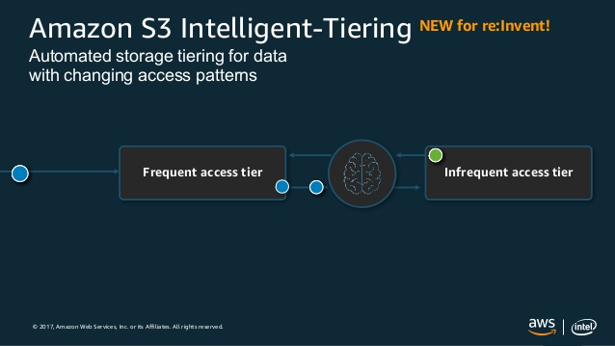

Slide 11
Building the flask app :
In this section, we build a web application that is integrated into the code we built.
A ui is provided for the users where they have to upload the images for sorting and prediction.
The uploaded images go to the s3 bucket with the original name only, and then checked for comparison with reference images, and the output is printed on the screen.
This section has the following tasks :
Building html pages
Building server-side script

Slide 12
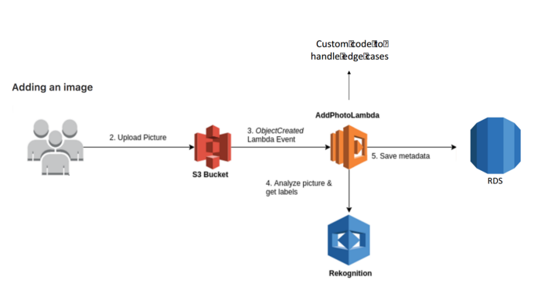
architecture

Slide 13
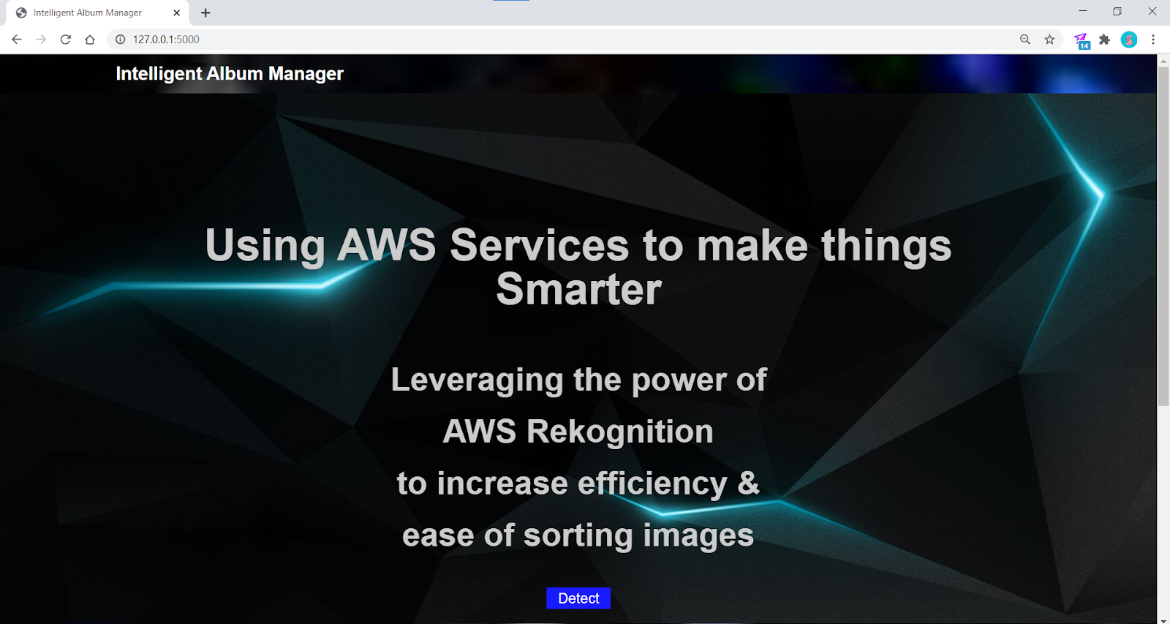

Slide 14
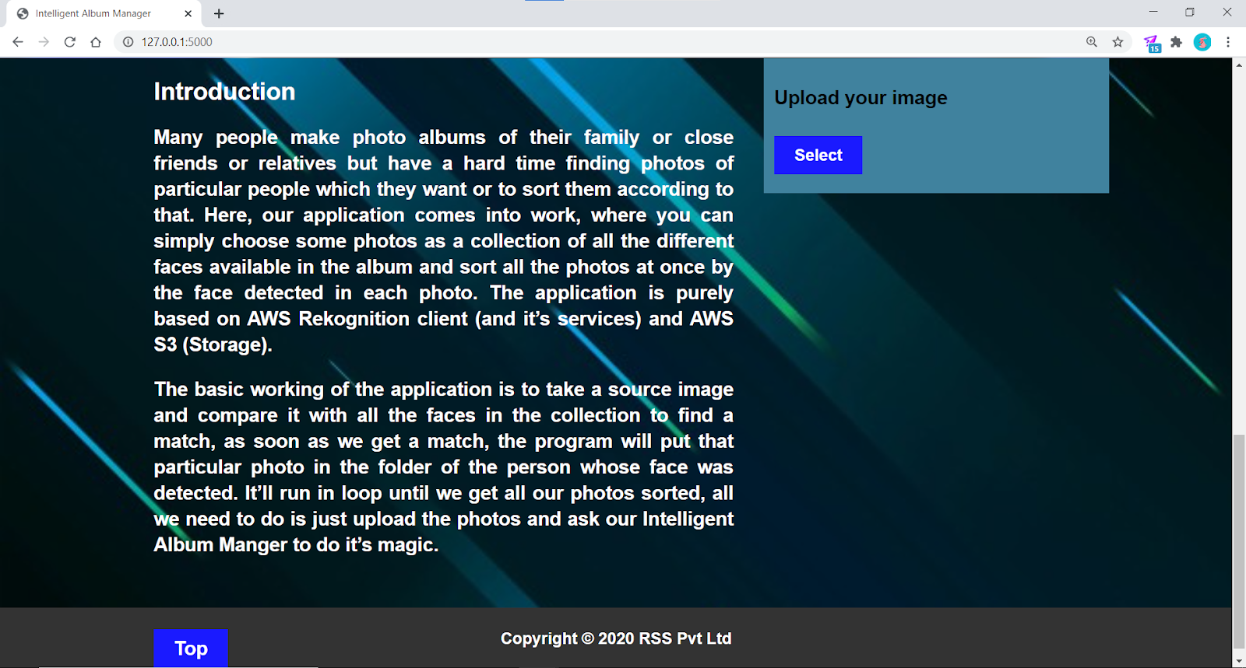

Slide 15
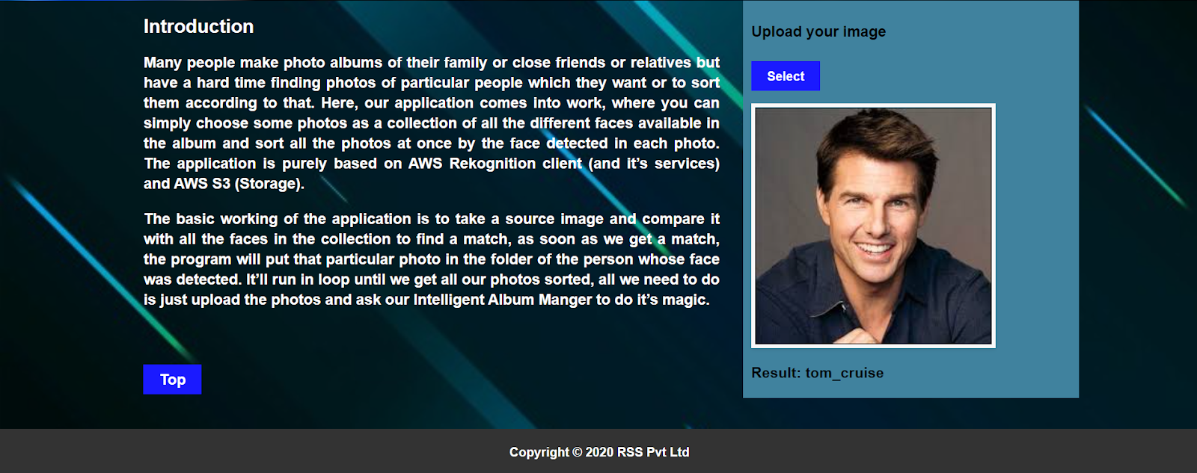

Slide 16
Conclusion
By using this application we can sort the images or photos from the album with the help of face detection.
Hence it is easier to find the photos in less time.

Slide 17


